Slide 1
Why did Europeans cross the seas?
As Europe’s population recovered from the Black Death, the demand for trade goods grew.
Europeans wanted spices.
European merchants wanted to gain direct access to the riches of Asia.
Some voyagers still wanted to crusade against the Muslims.
Others were inspired by the Renaissance spirit to learn about distant lands.

Slide 2
Motives for Exploration
Attracted to East for silks and spices
Difficult to trade with Islamic empires
  1453 Byzantine Empire fell to Turks
desire for wealth and adventure
religious zeal- save souls
Summary
  Gold, Glory and God

Slide 3
Improve Navigation
Better maps, follow coasts at first, used compass
better ships- square sails and new hull design, heavy enough to carry canon
use of astrolabe- magnetic compass sail by stars
knowledge of wind patterns
First the Portuguese (Prince Henry) then Spanish, France and England

Slide 4
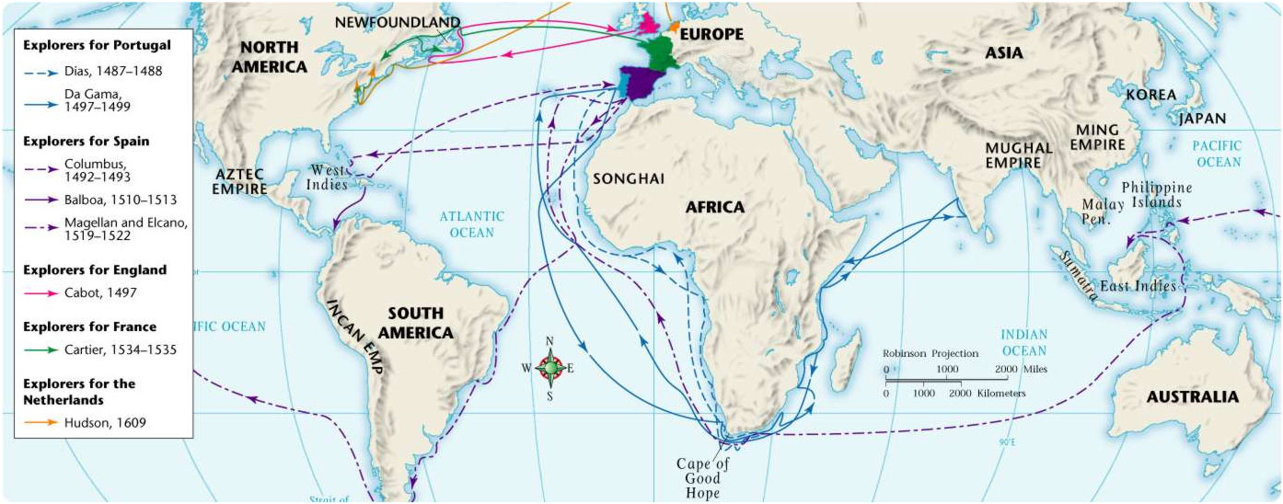
Early Voyages of European Exploration, 1487–1609

Slide 5




MOTIVATING FORCES FOR EXPLORATION
Economic:
  Gold
  Natural resources
  Trade
Religious
Competition for empire and belief in superiority of own culture

Slide 6
OBSTACLES TO EXPLORATION
Poor maps and navigational tools
Disease / starvation
Fear of unknown “?”
Lack of adequate supplies

Slide 7
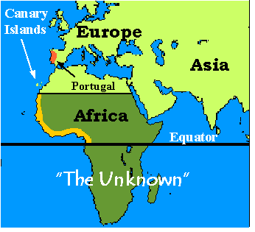
Regions Explored by Portugal

Slide 8
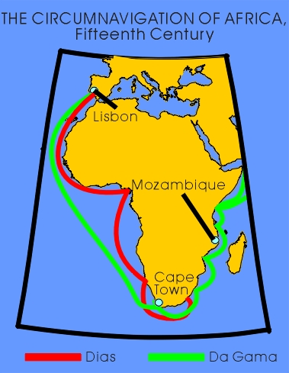
The Portuguese yearned to find a sea route to India to thwart Arab “middlemen” who controlled overland routes, keeping prices of pepper and other spices high by keeping supplies low.
    Glory, God or Gold?

Slide 9
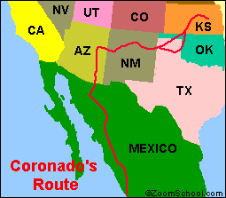
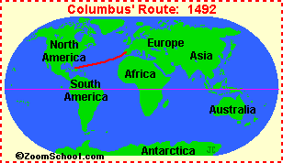
Regions explored by Spain

Slide 10
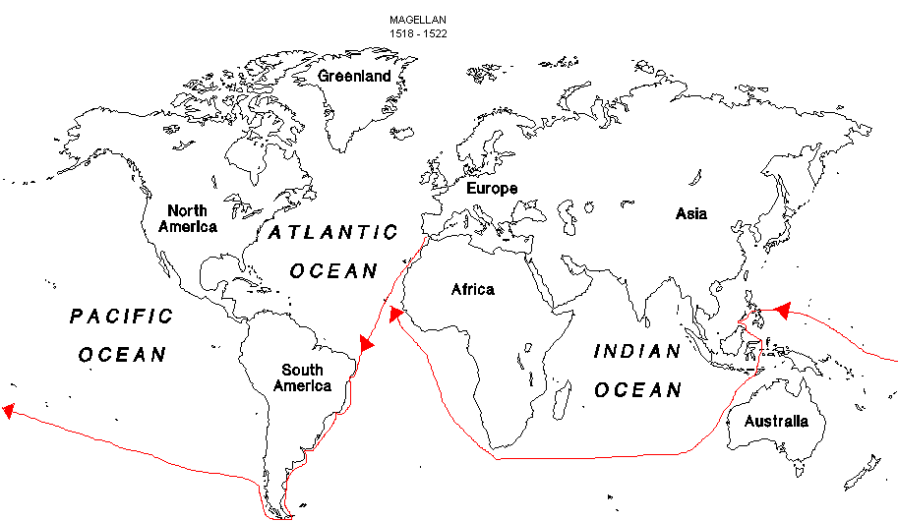
Magellan’s Voyage
Although the voyage is attributed to Magellan, he did not succeed in the circumnavigating globe. He was killed on the island of Mactan.

Slide 11
CULTURAL INTERACTION
SPAIN
Conquered and enslaved Indians
Brought Christianity to New World
Brought European Diseases to Indians

Slide 12
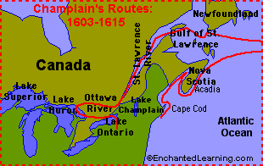
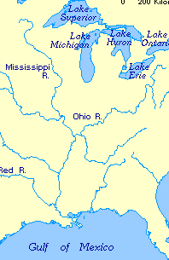
Regions Explored by France

Slide 13
CULTURAL INTERACTION
FRANCE
Established trading posts
Spread Christianity

Slide 14
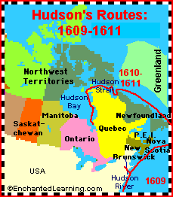
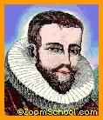

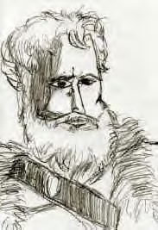
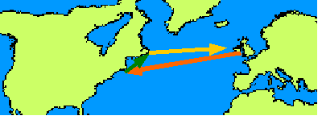
Regions Explored by England
Cabot Map Eastern Canada

Slide 15

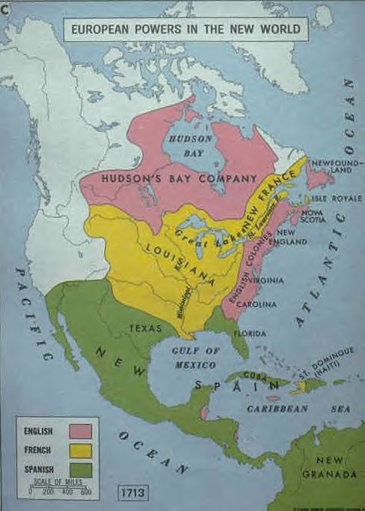
ACCOMPLISHMENTS OF EXPLORATION:
Exchanged goods and ideas
Improved navigational tools and ships
Claimed territories (Map)

Slide 16
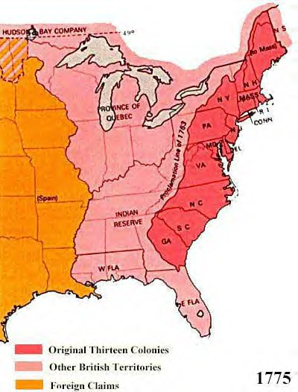
CULTURAL INTERACTION ENGLAND
Claimed ownership of land; settlements
Learned farming techniques
Traded

Slide 17
AREAS OF COOPERATION
Technologies (transportation of weapons and farm tools
Trade
Crops

Slide 18
AREAS OF CONFLICT
Land
Competition for Trade
Differences in cultures
Disease
Language Difference

Slide 19





Columbian Exchange
From America –
  Corn
  Potatoes
  Beans
  Chocolate
  Buffalo
  Beaver
  Parrots

Slide 20








From Europe
Oranges
Onions
Sheep
Horses
Cattle
Honeybees
Pigs
Chickens
Diseases (?)

Slide 21
Exploration questions
What were 3 motivating forces for exploration?
What were 4 obstacles to exploration?
What were 3 accomplishments of exploration?
What regions of North America were explored by Spain, France, & England?
Where did the Portuguese explore?
Explain cultural interactions of each nation with the Indians.
What were 3 areas of cooperation?
What were 5 areas of conflict?
Identify the location and describe the characteristics of West African societies (Ghana, Mali, and Songhai) and their interactions with traders.

